Slide 1

BU Spark! Athletics

Slide 2

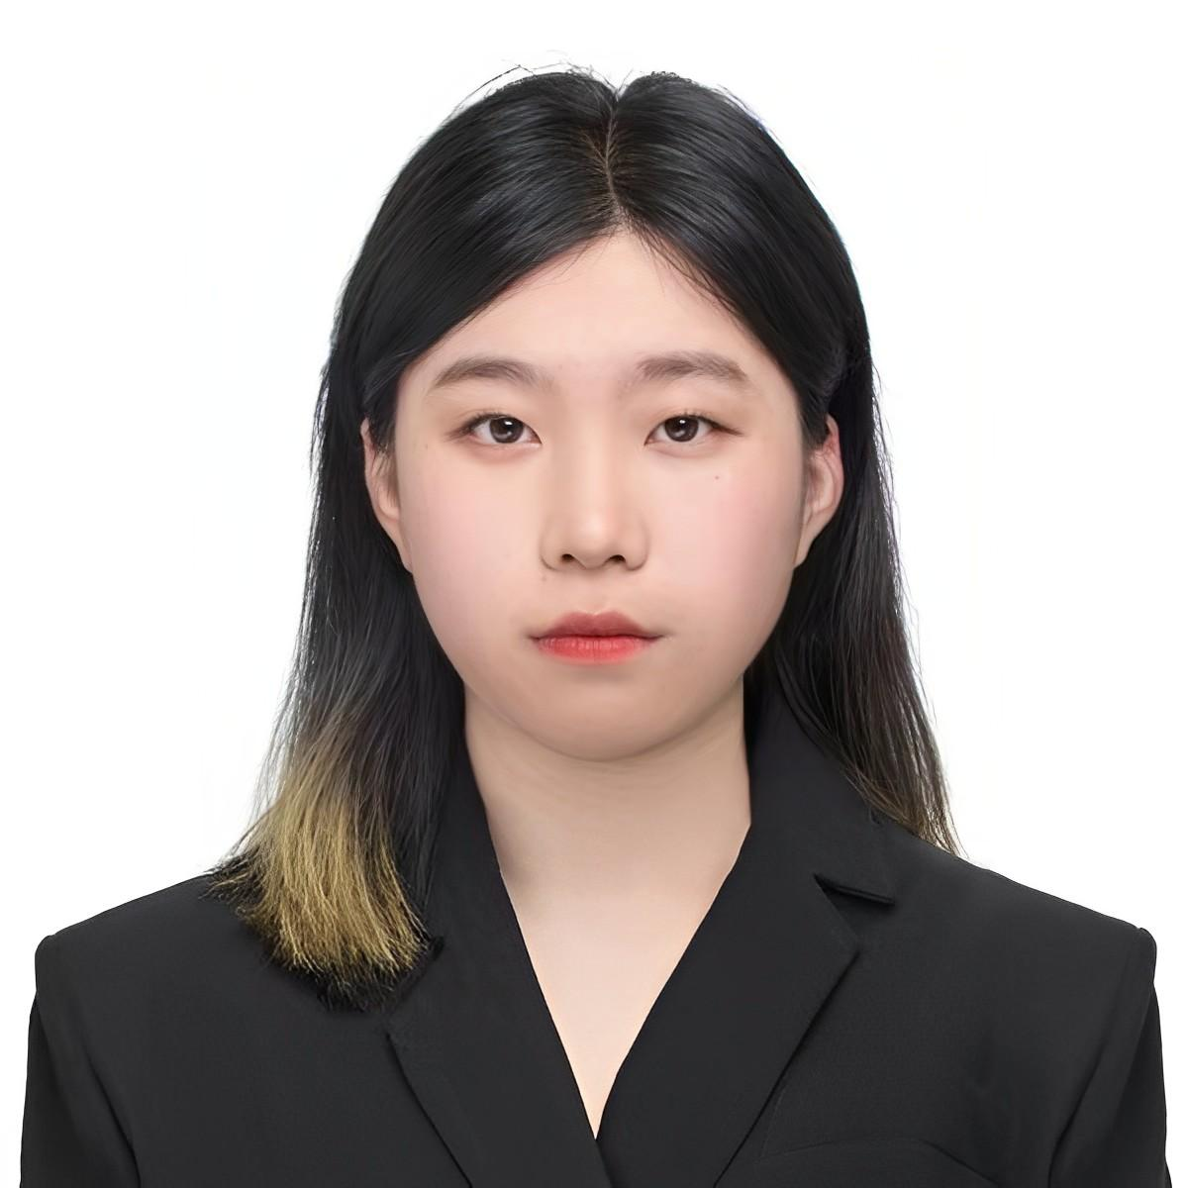
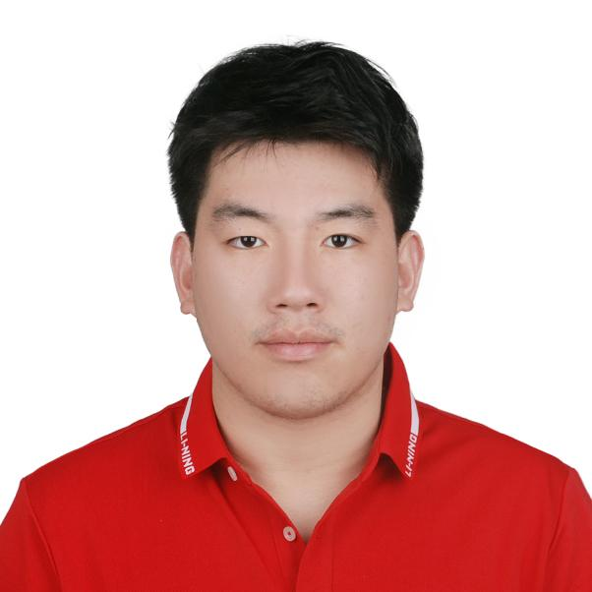
Team Breakdown
Yuchen Li
MSDS
1st Year Graduate
Shiyi Chen
MSDS
1st Year
Graduate
Steven Chen
MSDS
1st Year
Graduate

Slide 3
Project Overview
First Sprint: Data Review; Task breakdown
Analysis Done; Report Drafted & Feedback Collected
Oct 13
Dec 4
Sep 29
Nov 11
Data Cleaning; Code uploaded onto Github
Final Presentation & Final Report Submission

Slide 4
Key Tasks to Complete
Team Agreement & Logistics
Understand the project
Read through the PD
Get to know the objectives
Build backlog
Understand the data
Download and review the datasets
Preliminary analysis (individually)
Data Cleaning

Slide 5
Process
Team Agreement & Logistics
Understand the project
Read through the PD
Get to know the objectives
Build backlog
Understand the data
Download and review the datasets
Preliminary analysis (individually)
Data Cleaning

Slide 6
Output
For Data Cleaning, we did:
Dropped all unnecessary columns (Student Athletic Team 2, Team 3)
Verified certain columns are numerical. If not, convert it to numerical
We also created separate CSV files for:
Data with High School GPA
Students with ACT/SAT scores, and one for those without.
Based on the high school GPA range (2.3-4.3), categorized the data into 3 ranks (2.0-3.5, 3,5-4.0, 4.0-4.5) and saved into separate CSV files
UNDERGRAD VS. GRAD/NON-DEGREE students (the latter often lack high school records)
International VS. domestic students
For International students: removed admission publication region, home state, and race/ethnicity columns
For domestic students, removed the world region of citizenship column

Slide 7
Future steps
Next Meeting Time: Oct. 25 (One Week Past the First Milestone)
Data Documenting
Upload data and code with proper documentation
Strategic Planning
Brainstorm strategies and approach to solve the primary problems
Data Analysis
Complete half of the problems proposed

Slide 8
Blockers and questions
Base Question 7: how do we determine if a student “switches major”?
Data only show students’ current major
High School GPA Scale
Missing High School GPA for Graduate Students
Missing Home Admission Publication Region for International Students
Use “Citizenship” instead?

Slide 9

Thank you!

